Slide 1
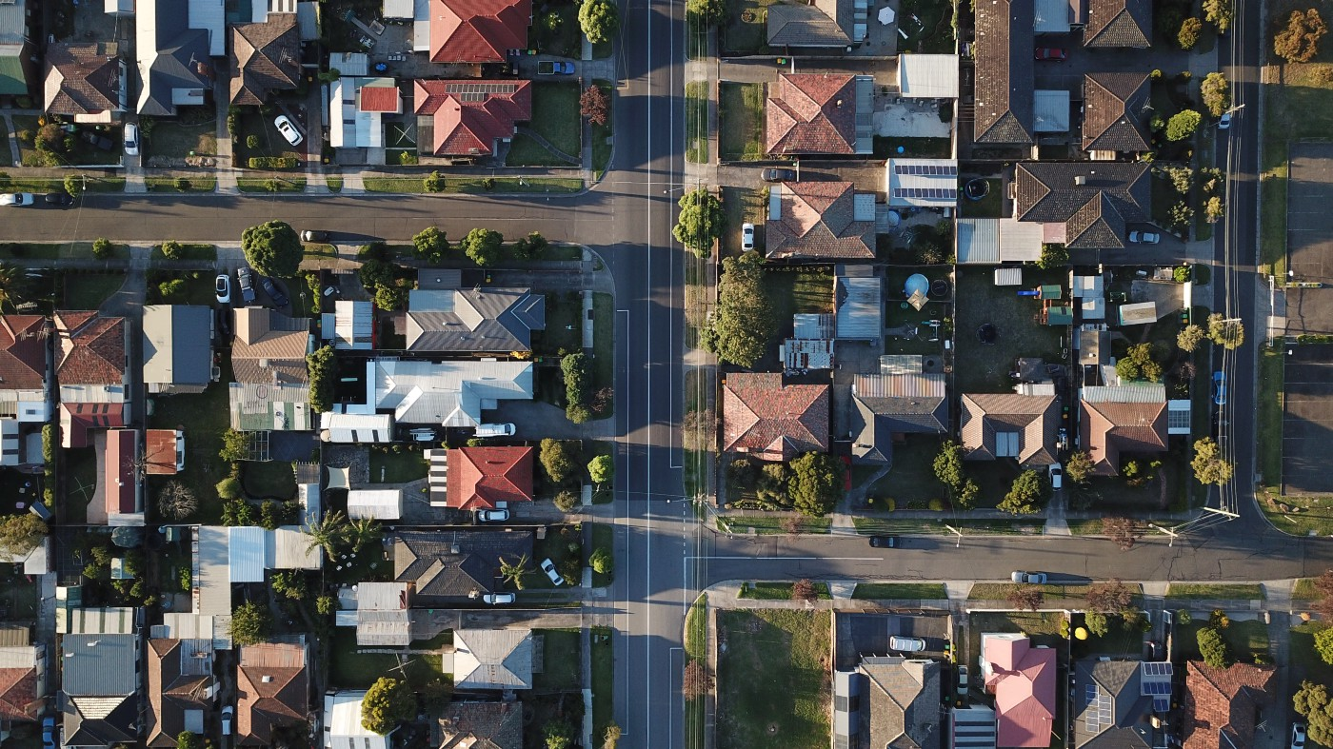
Data Science Project
Chen Russo, Carmel Levi
GitHub

Slide 2

Project Steps
research
question
Data acquisition Selenium
EDA
Conclusion
&
Answer
Data Handling
Machine learning

Slide 3


Research Question
Can a house price be predicted based on a few characteristics (floor, neighborhood, year of building construction etc..) ?

Slide 4


Data Acquisition

Slide 5
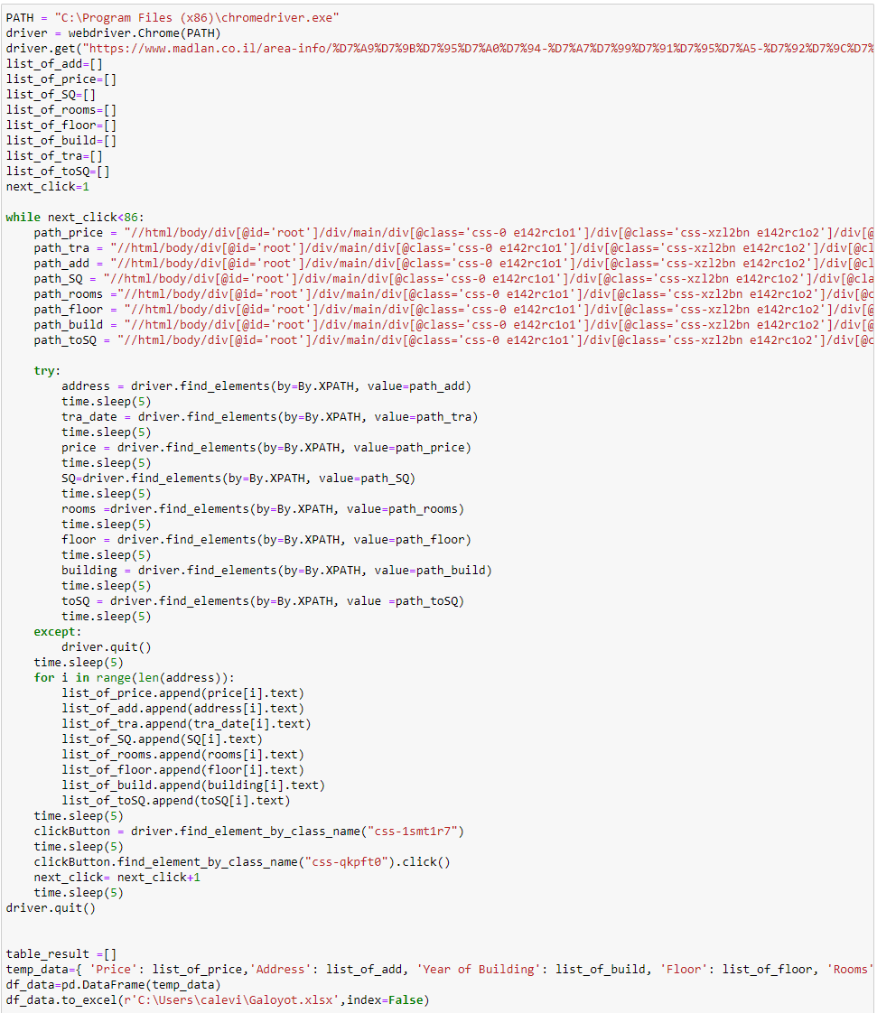
Data Acquisition
Our data is based on Madlan website which provide information about living environments, for those who are interested in real estate in Israel.
We collected the data using Selenium, a web scraping method. By using this method, we gathered information on eight neighborhoods in Haifa.
Difficulties:
We faced web blockages.
Inability to use crawling due to site structure, which forced us to use Selenium to solve the problem.

Slide 7


Data Handling

Slide 8
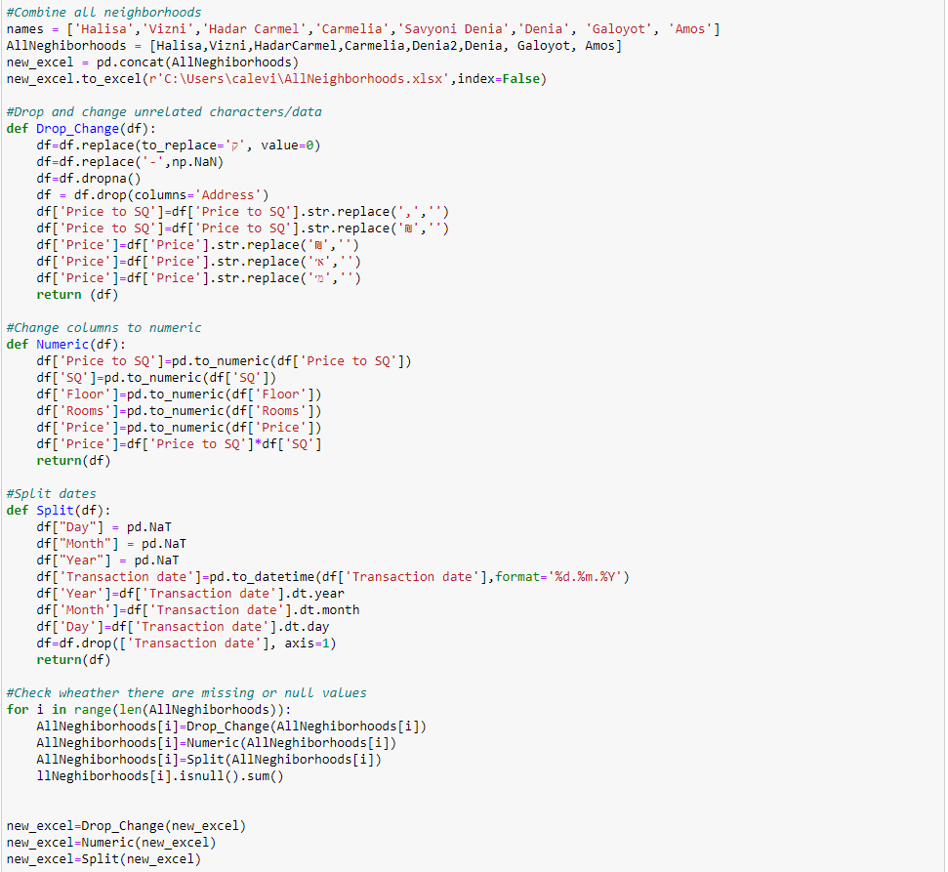
Data Handling
After gathering all the data through web scraping, there could be some mistakes in the collected entries such as: null or blank values, human errors, some impractical values which we call outliers.
In order to overcome these outliers, we needed to clean the data –
Drop unrelated characters.
Change columns to numeric.
Split date column.
Remove missing data.
Drop outliners .
Standard deviation.

Slide 10
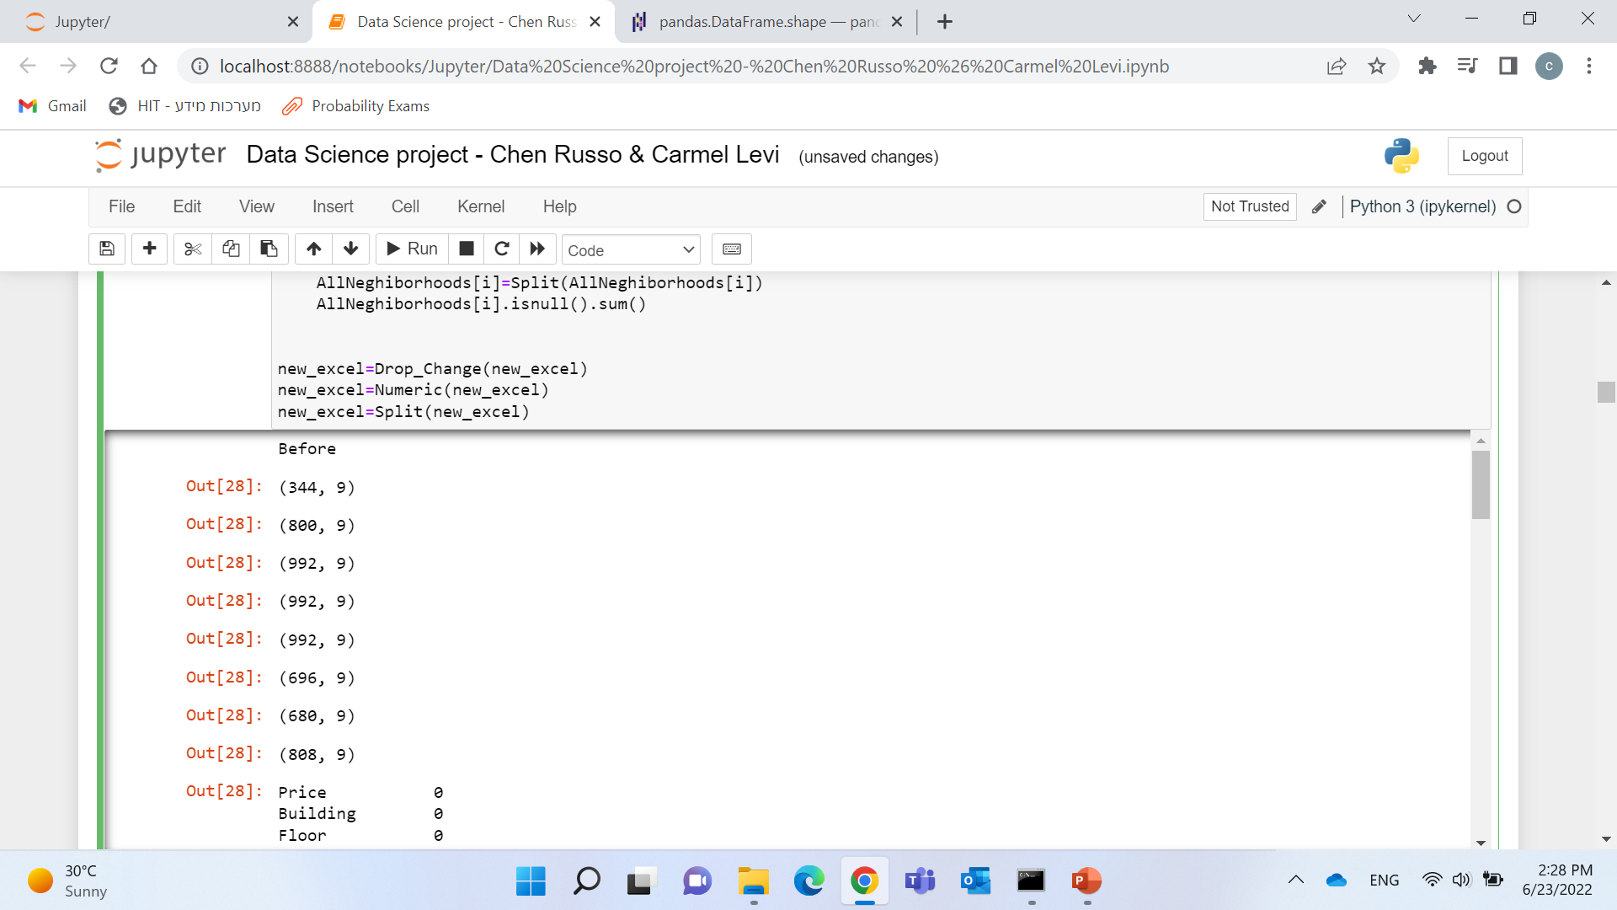
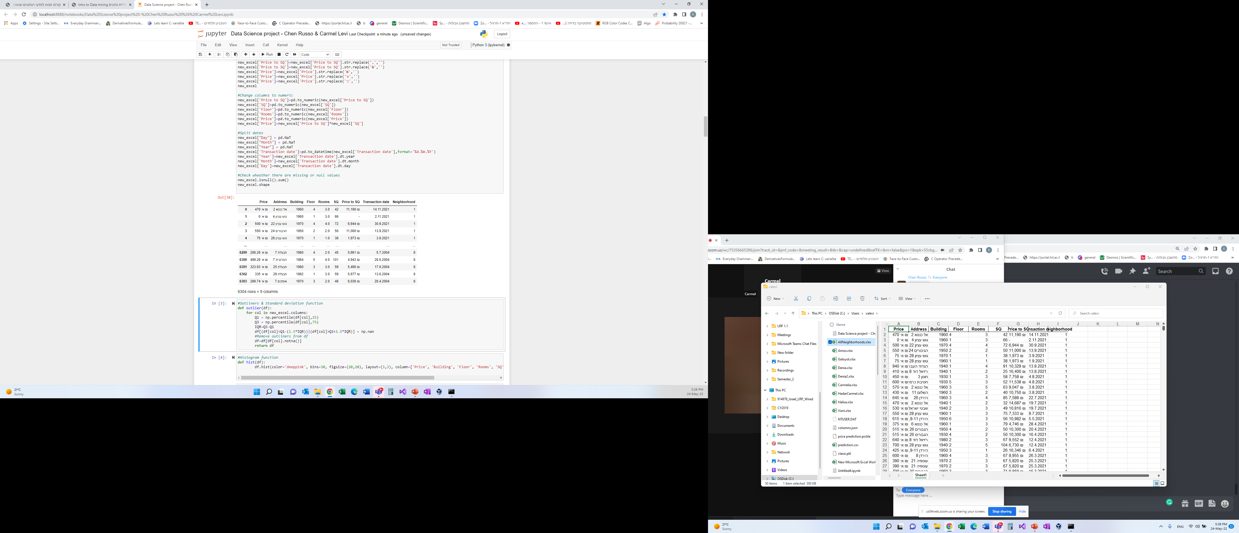

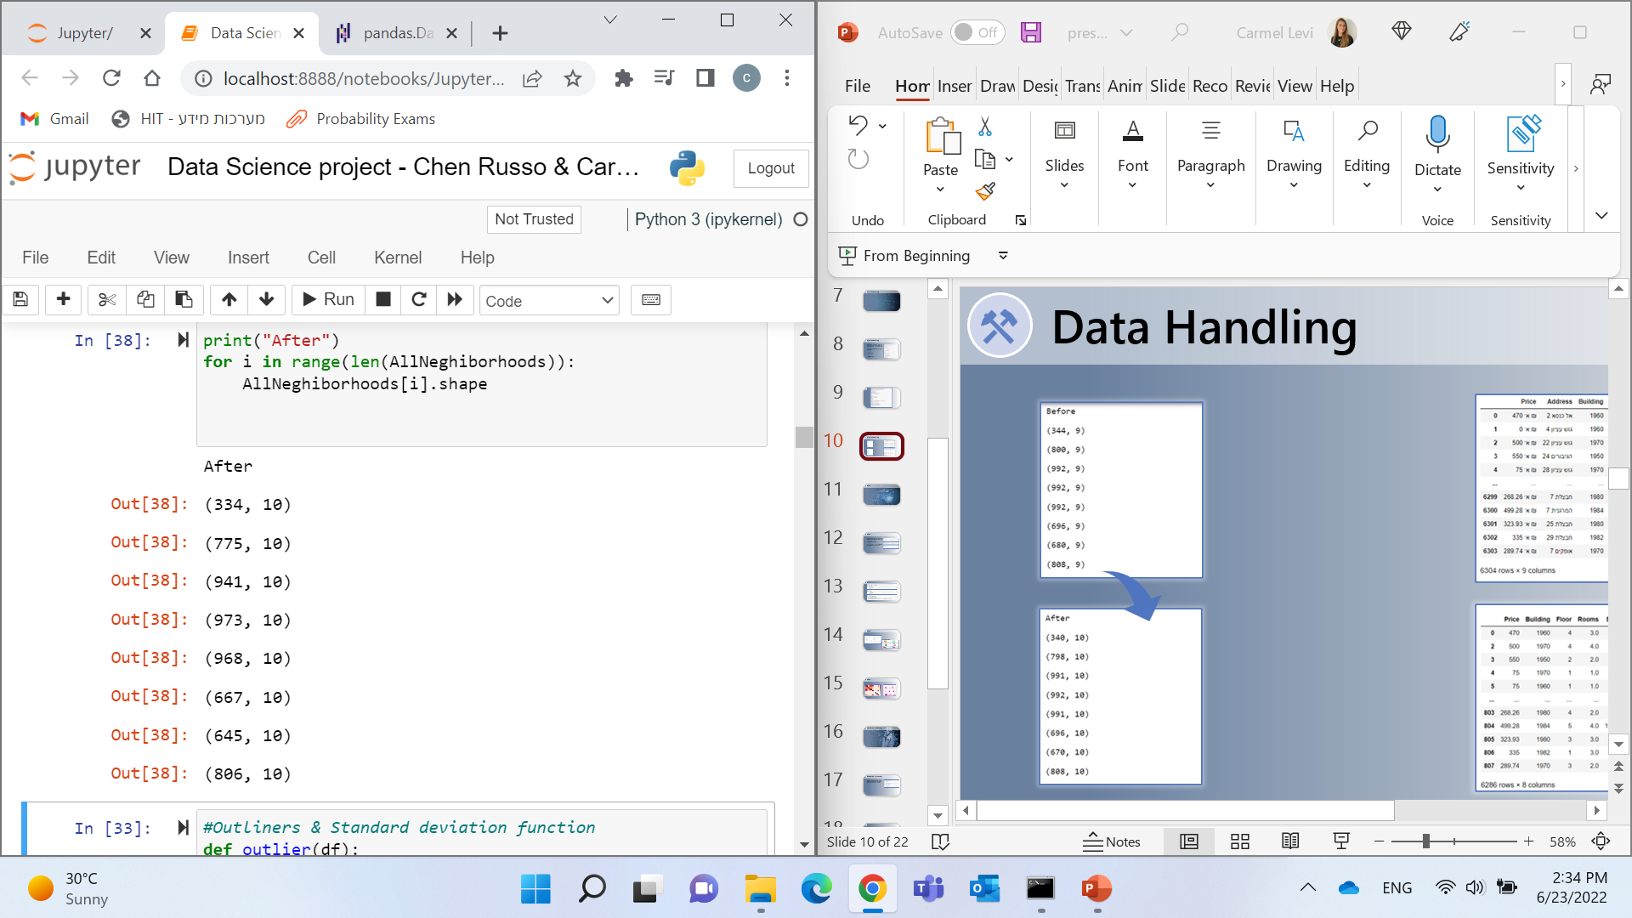
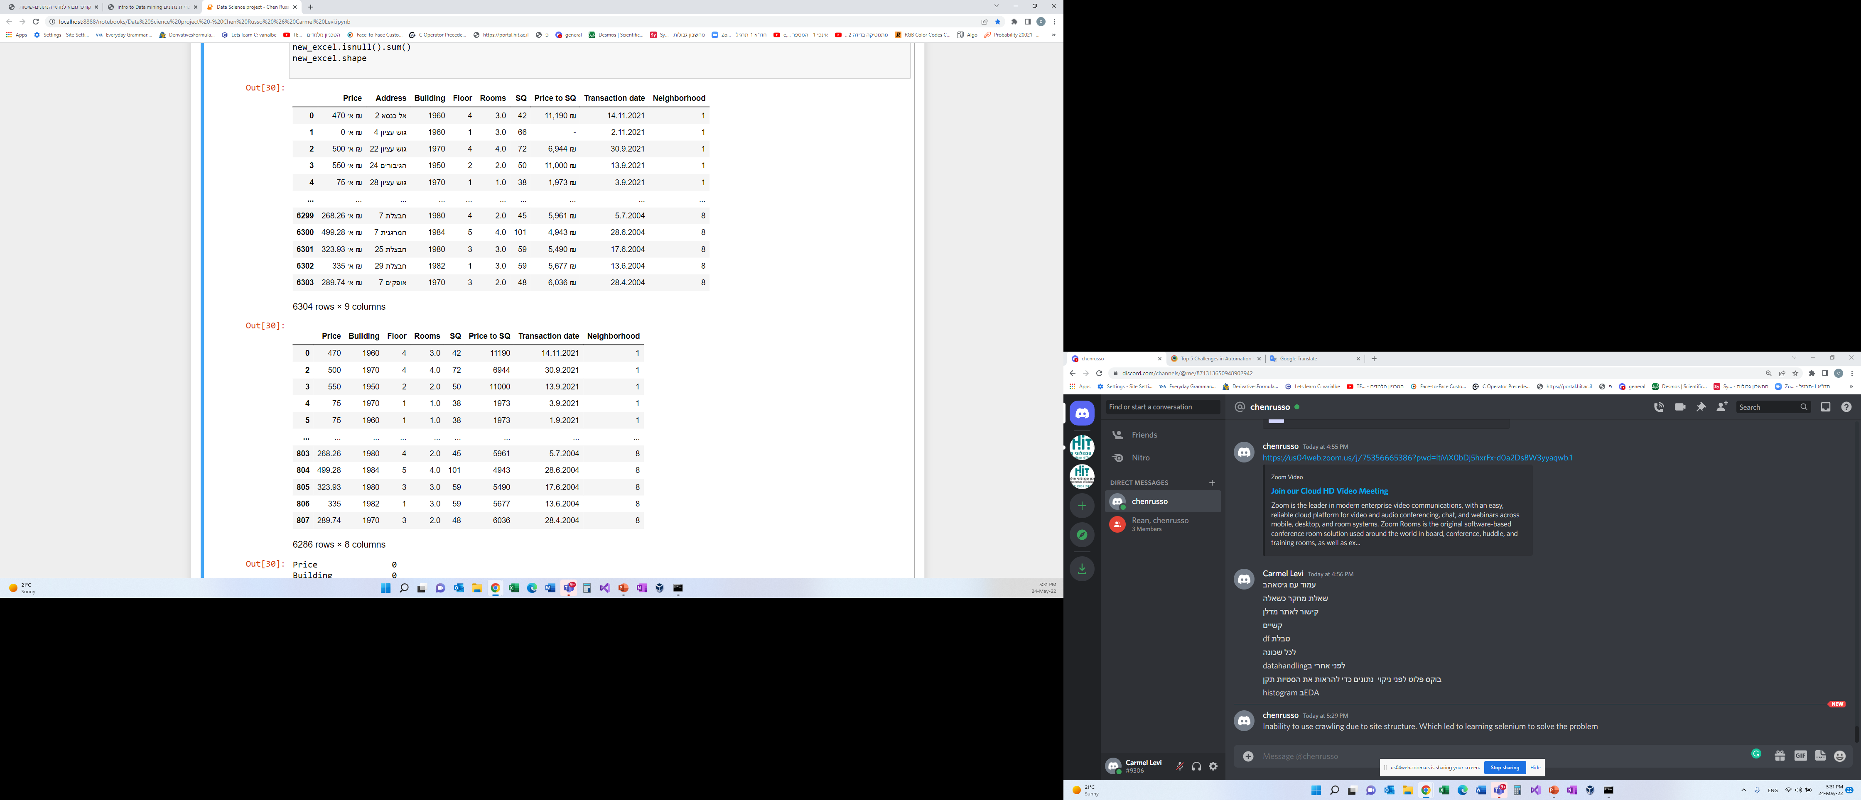
Data Handling

Slide 11


EDA

Slide 12
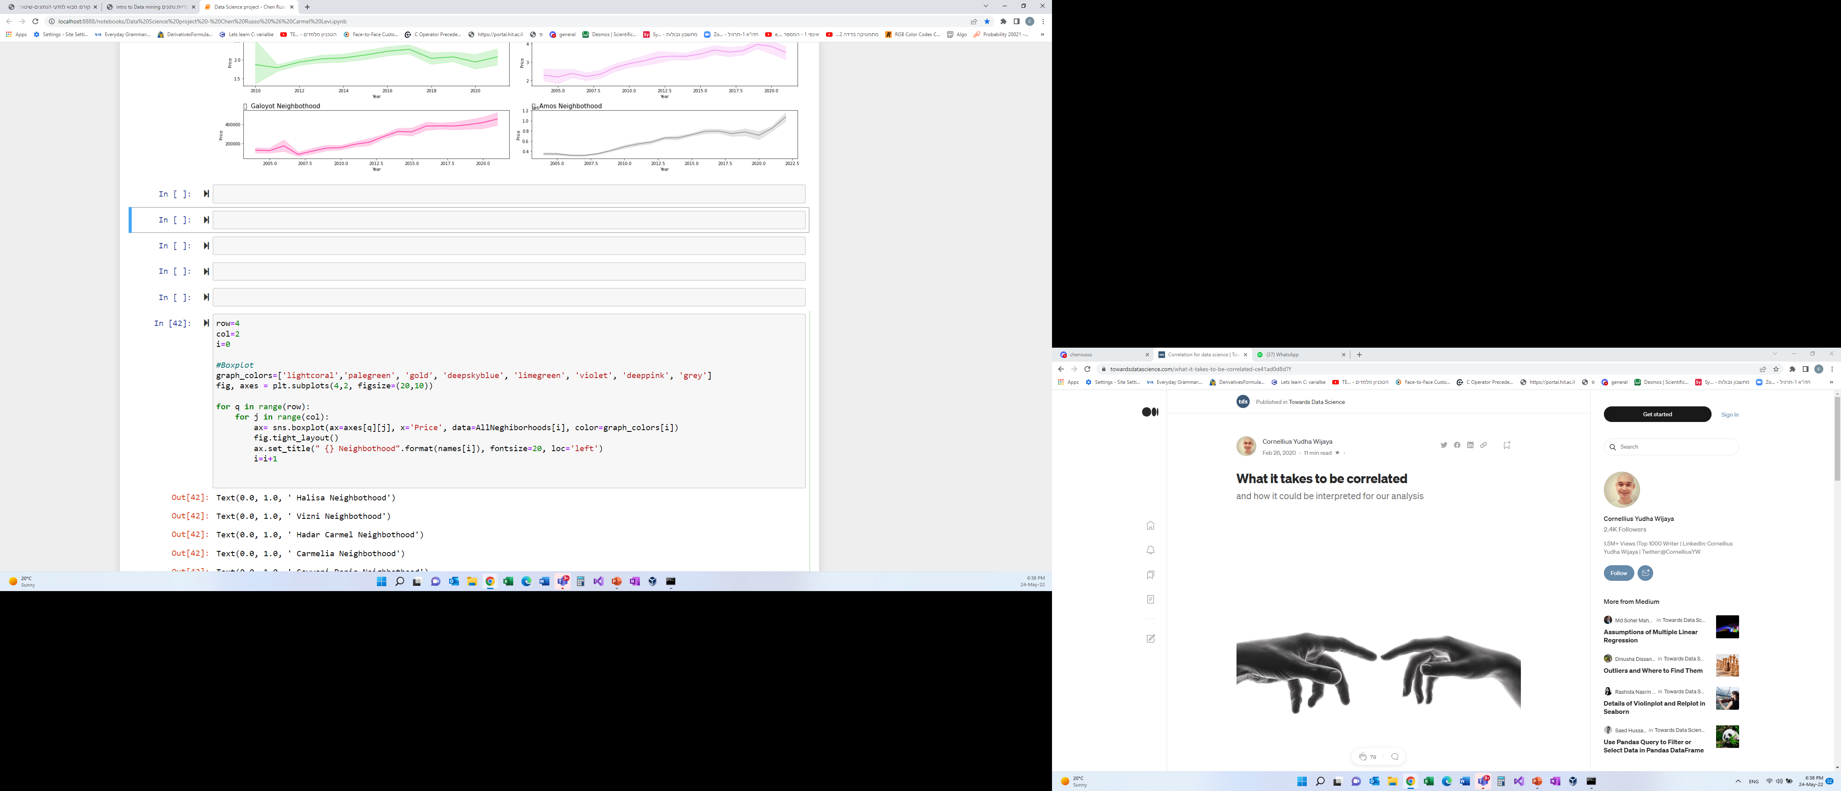
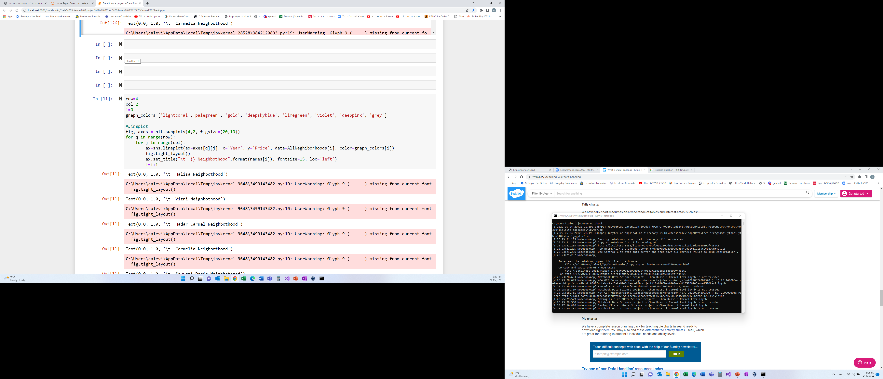
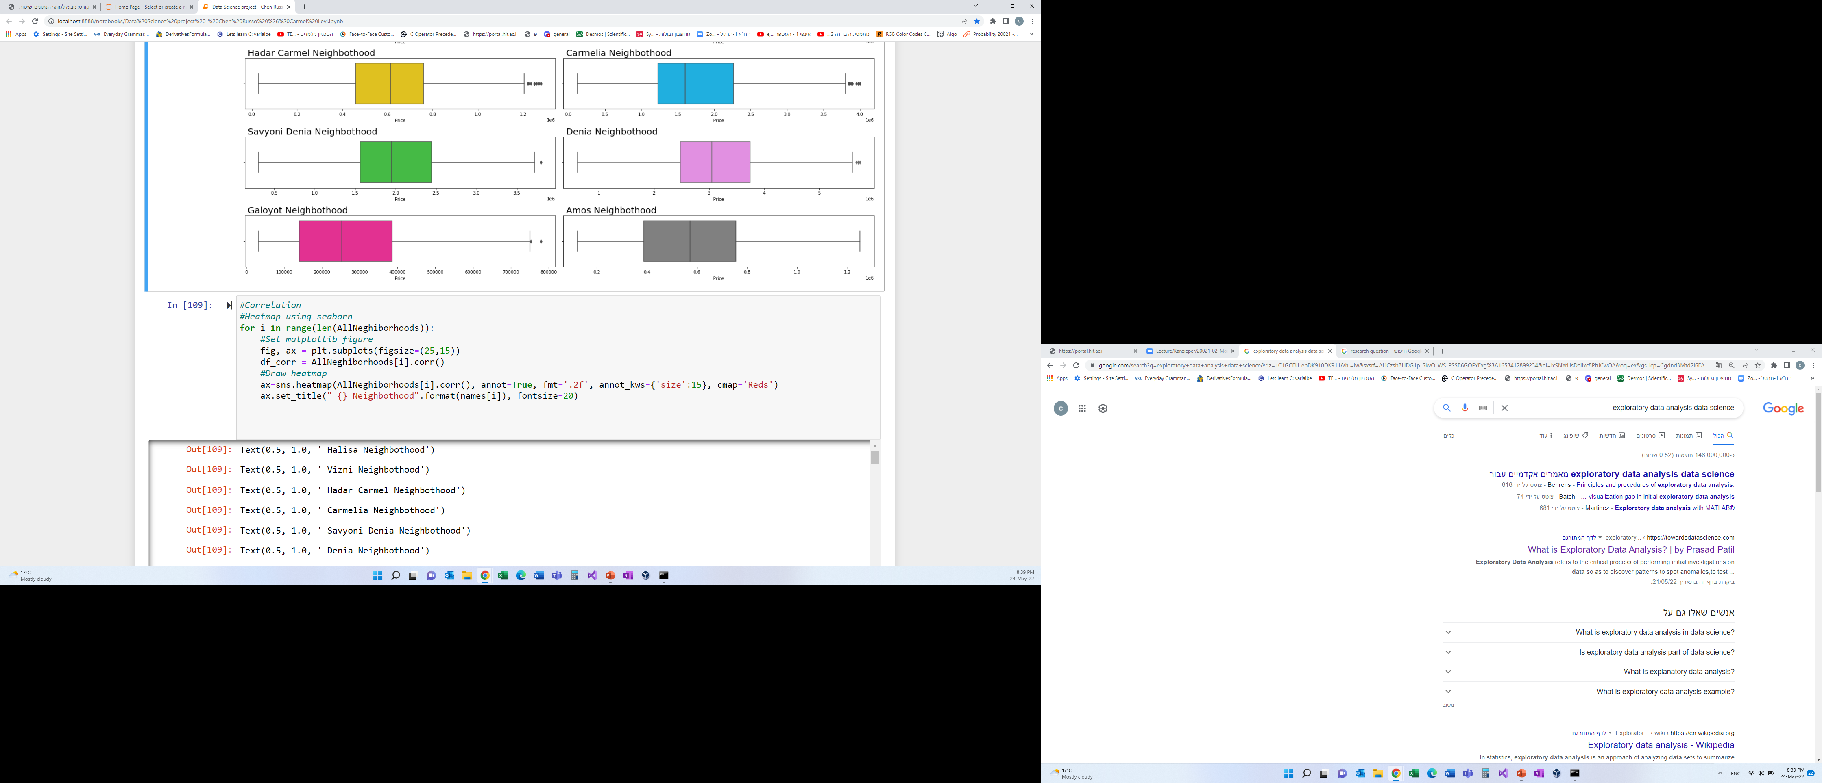
EDA
Analyzing data sets and summarizing their main characteristics, often using statistical graphics and other data visualization methods.
In our project we used histogram, line plot, box plot and heat map.

Slide 14
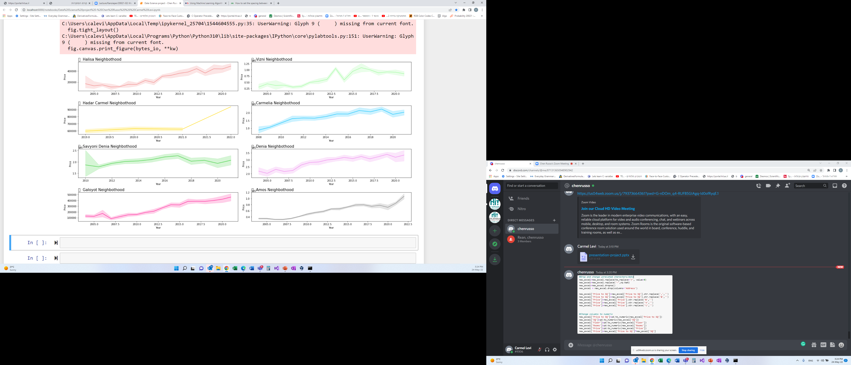
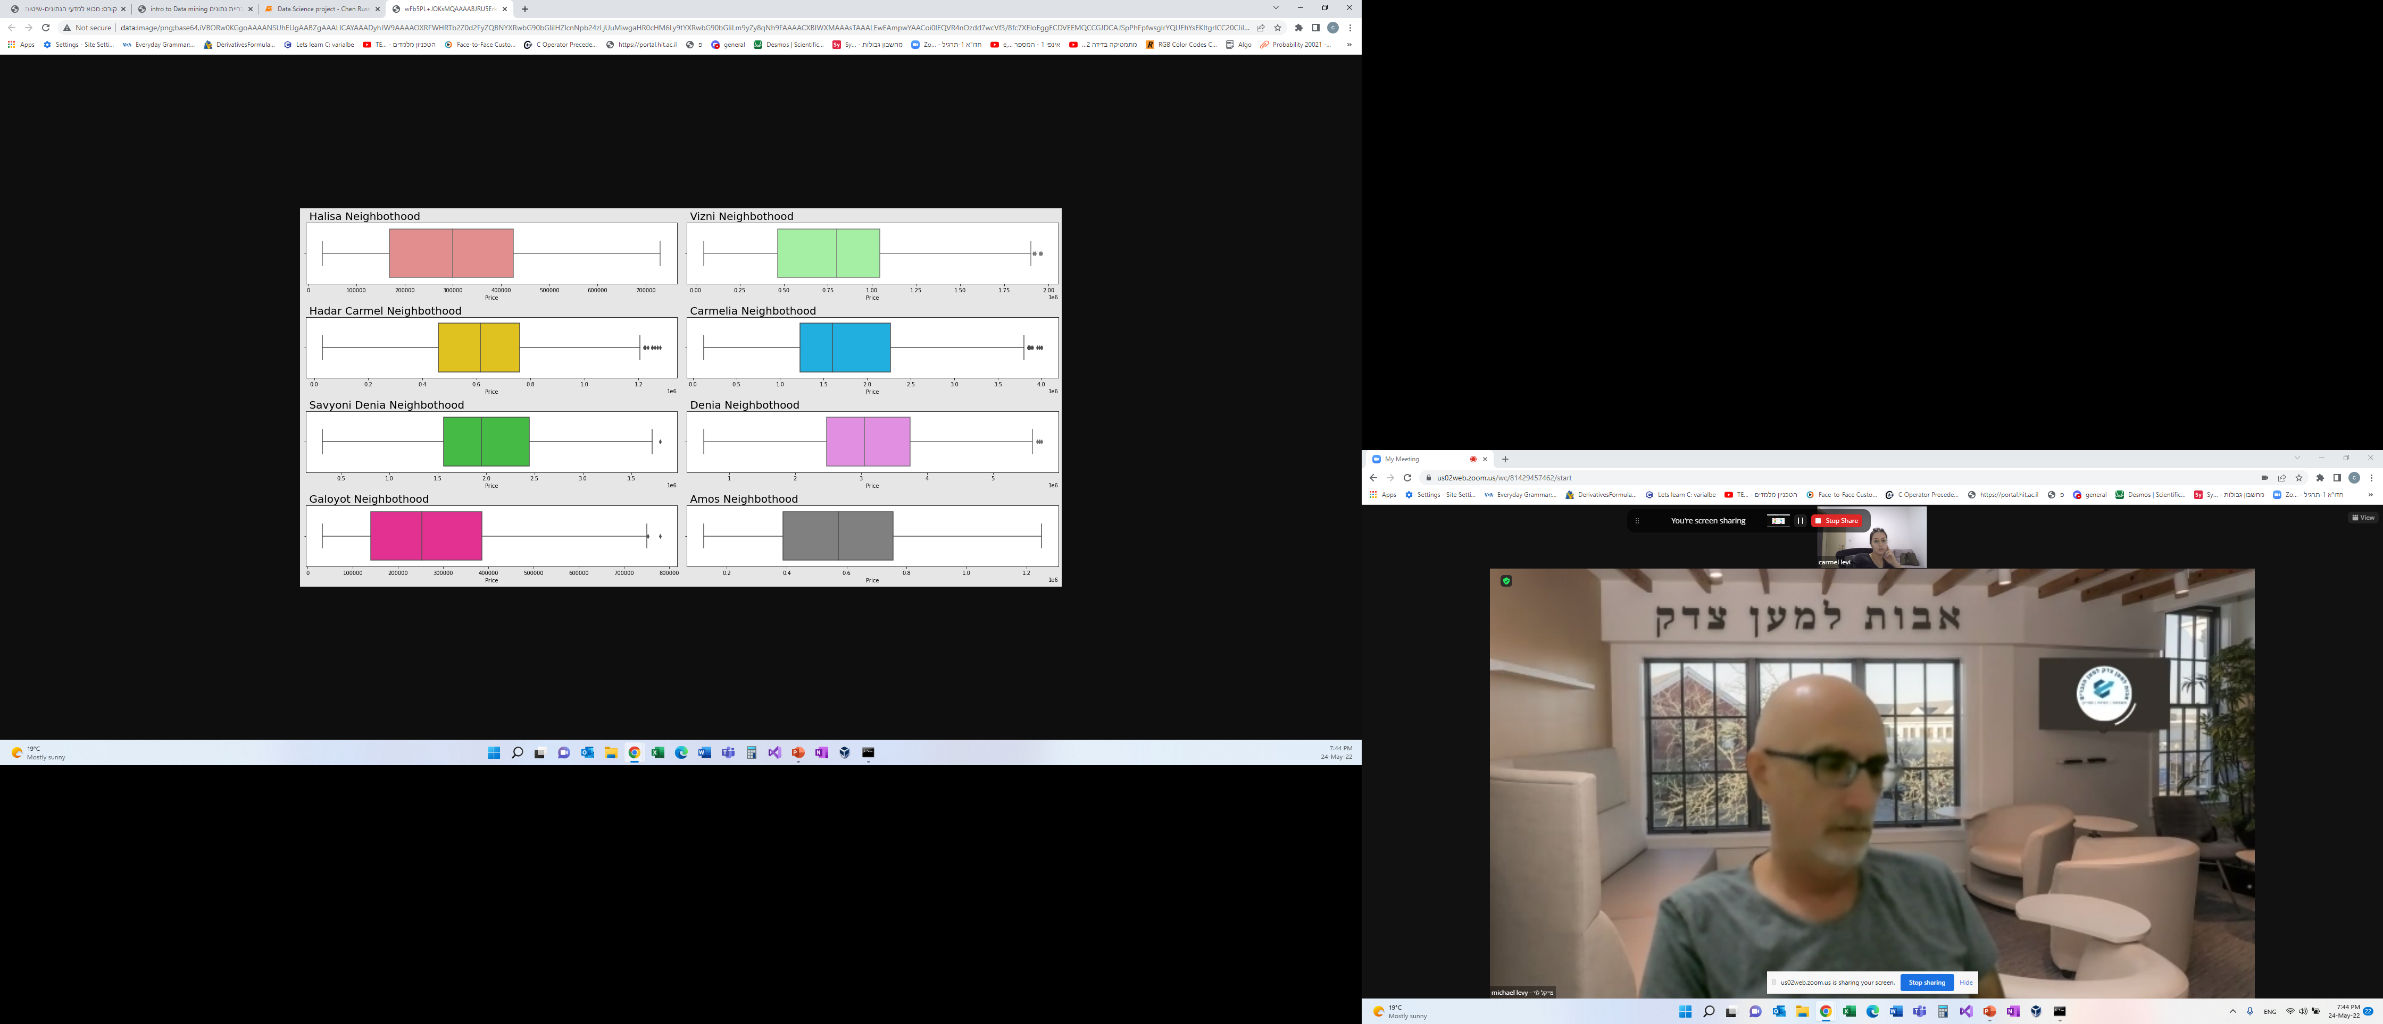
EDA
Price vs Year
Price distribution and median

Slide 15
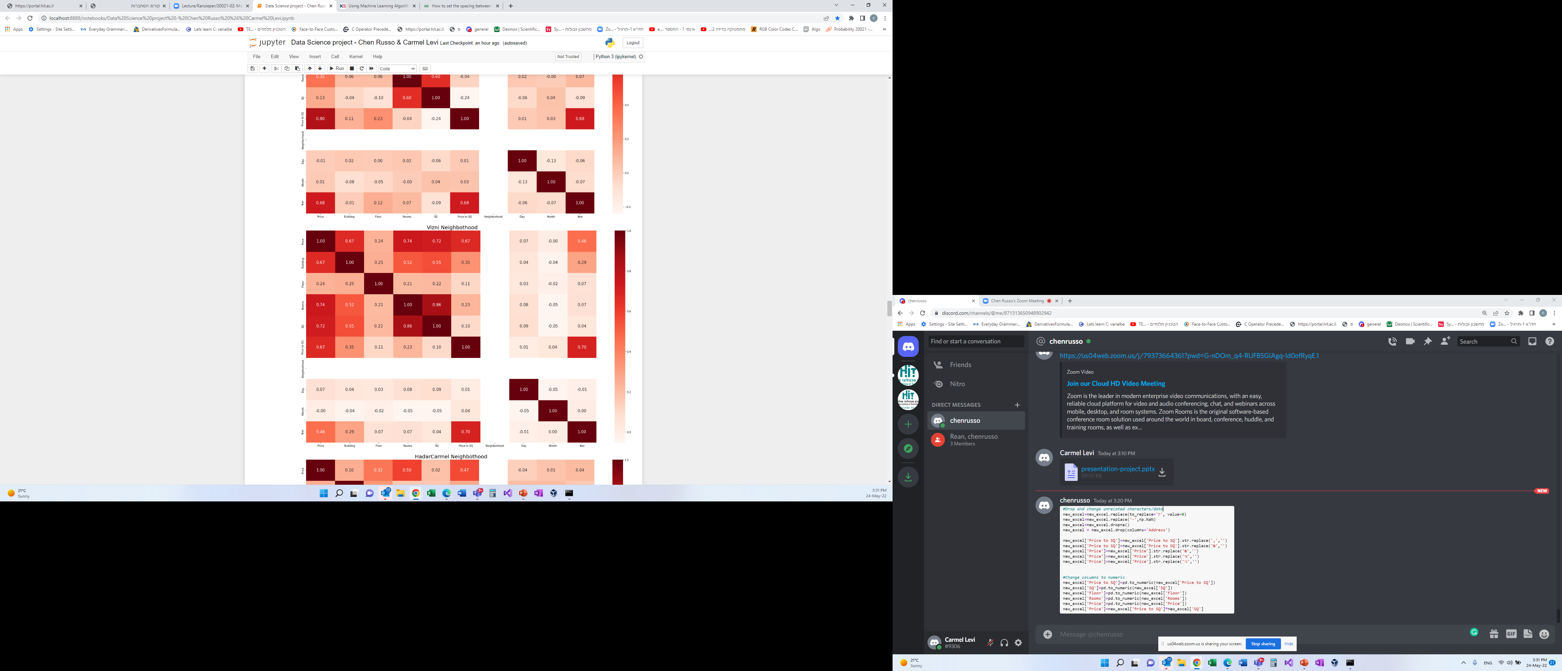
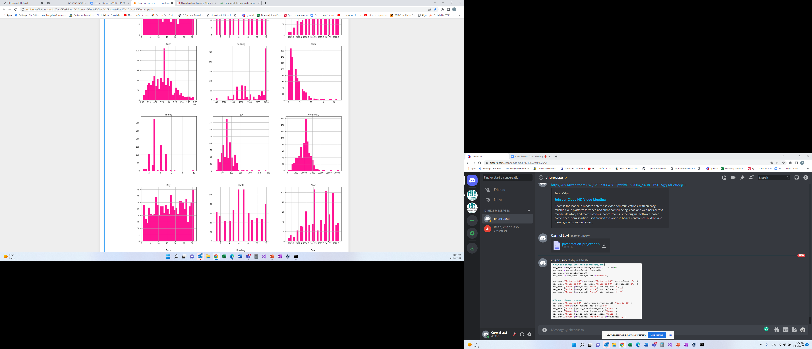
EDA
Correlation
Distribution for each column

Slide 16


Machine Learning

Slide 17
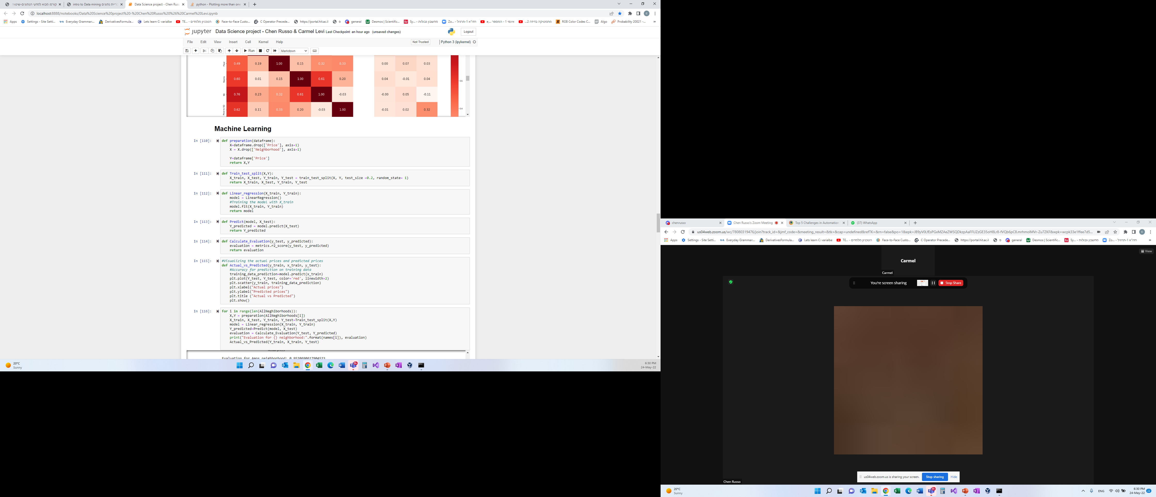
Machine Learning
We chose ‘linear regression’ models in this project because linear regression assumes that the relationship between continuous variables is dependent.

Slide 19
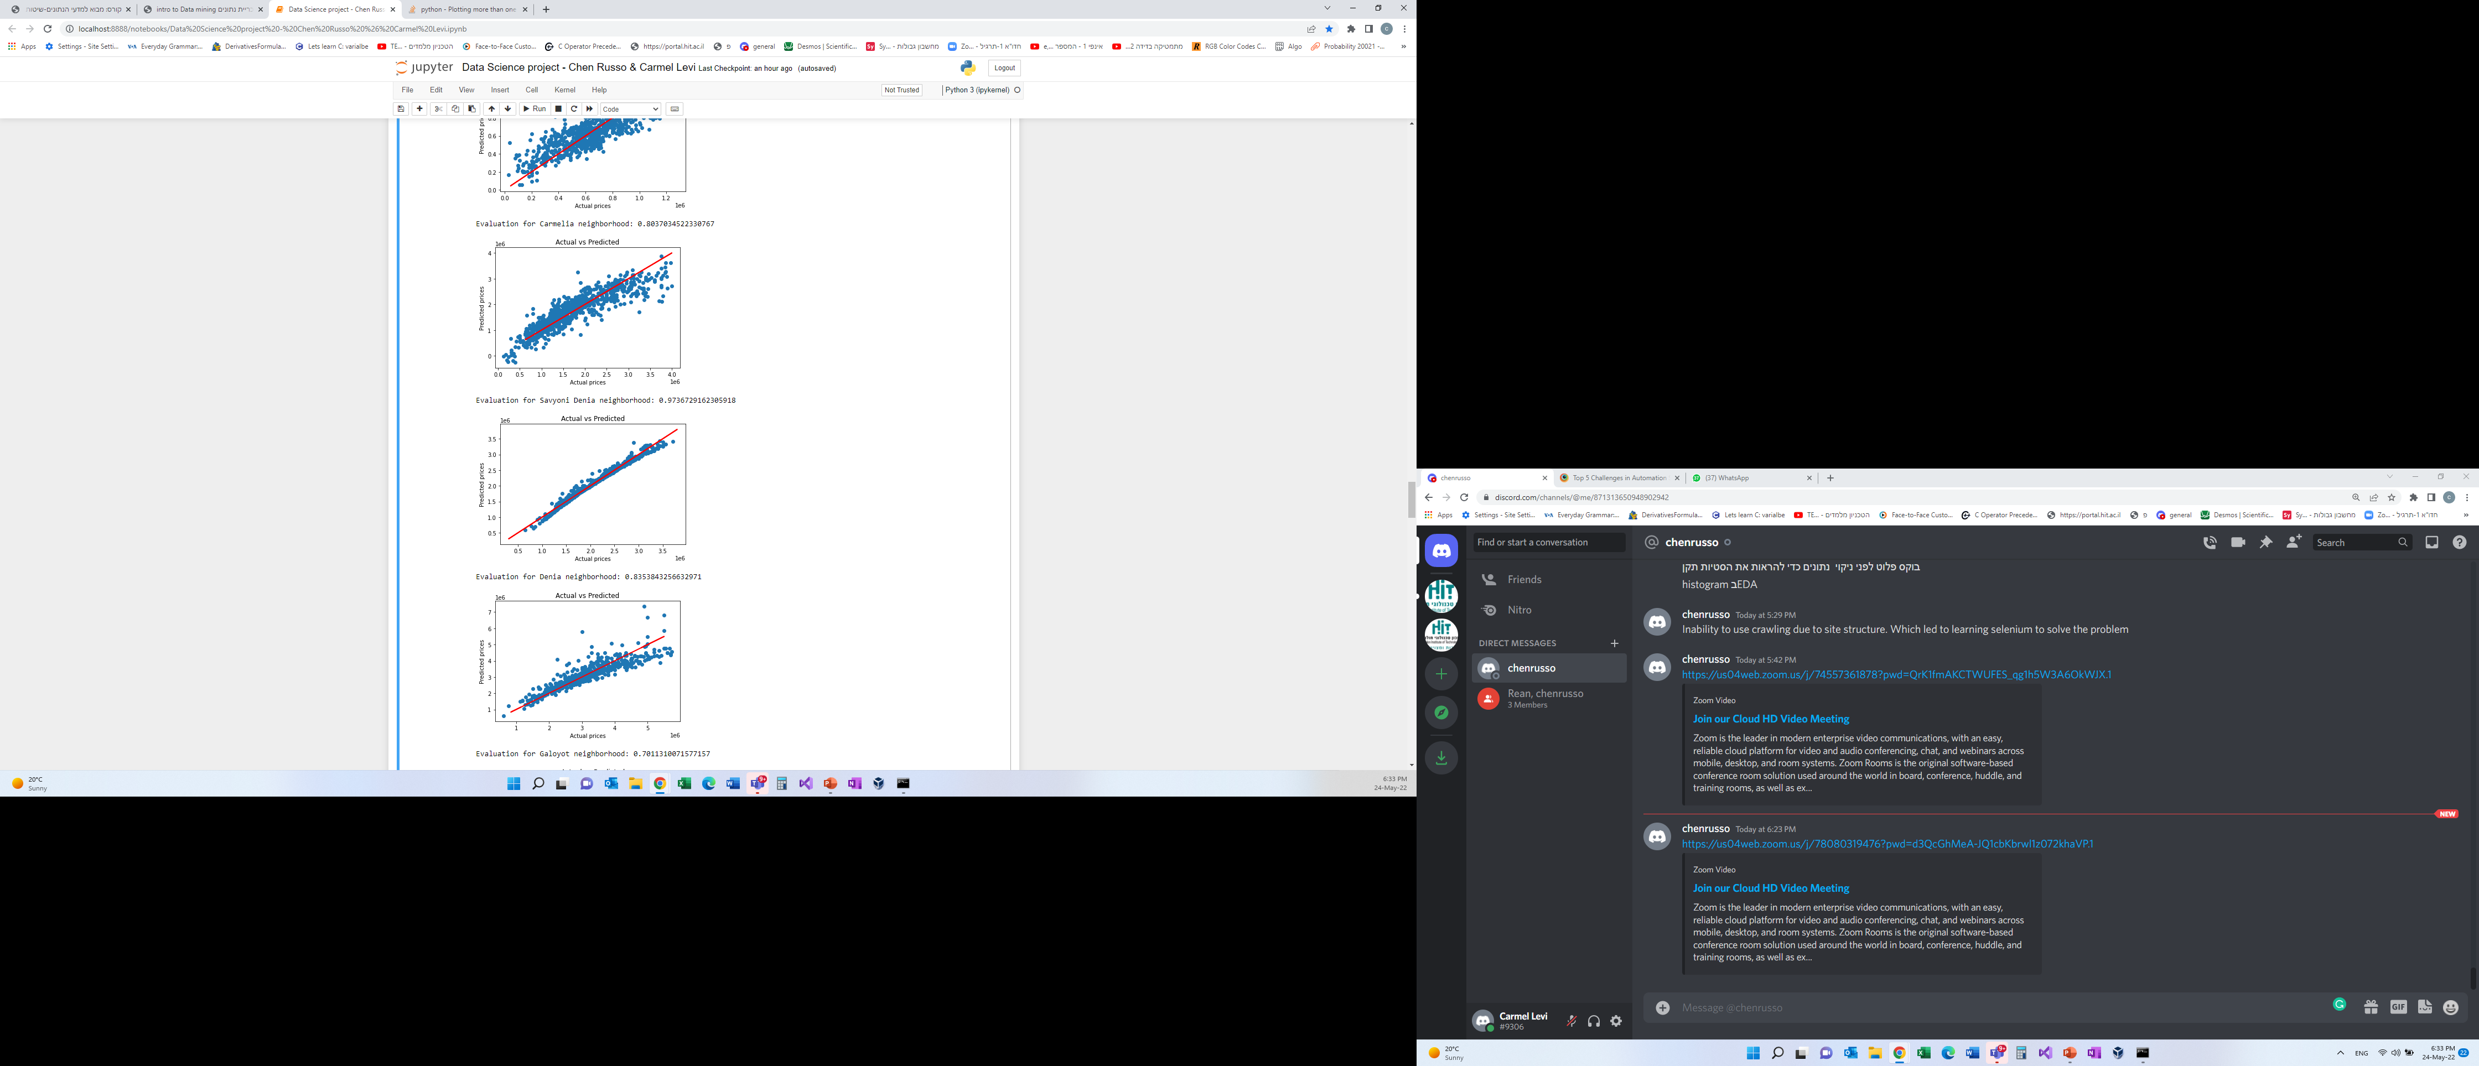
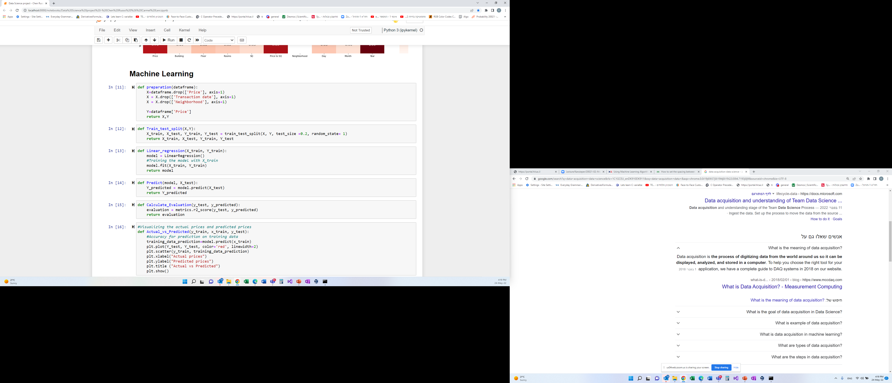
Machine Learning
Evaluation defined as the difference between the actual value and predicted value. The goal is to reduce this error or difference.

Slide 21


Conclusion& Answer

Slide 22
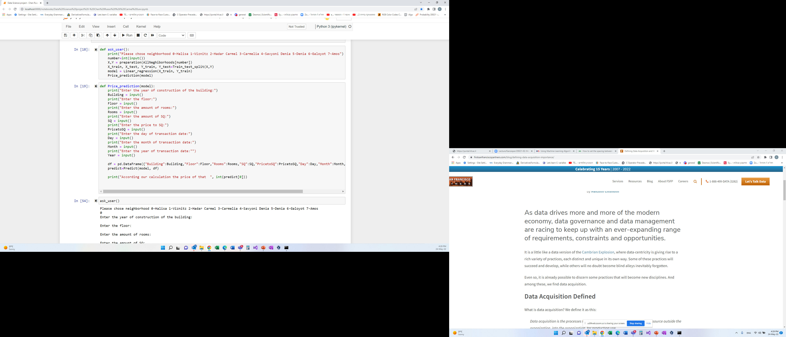
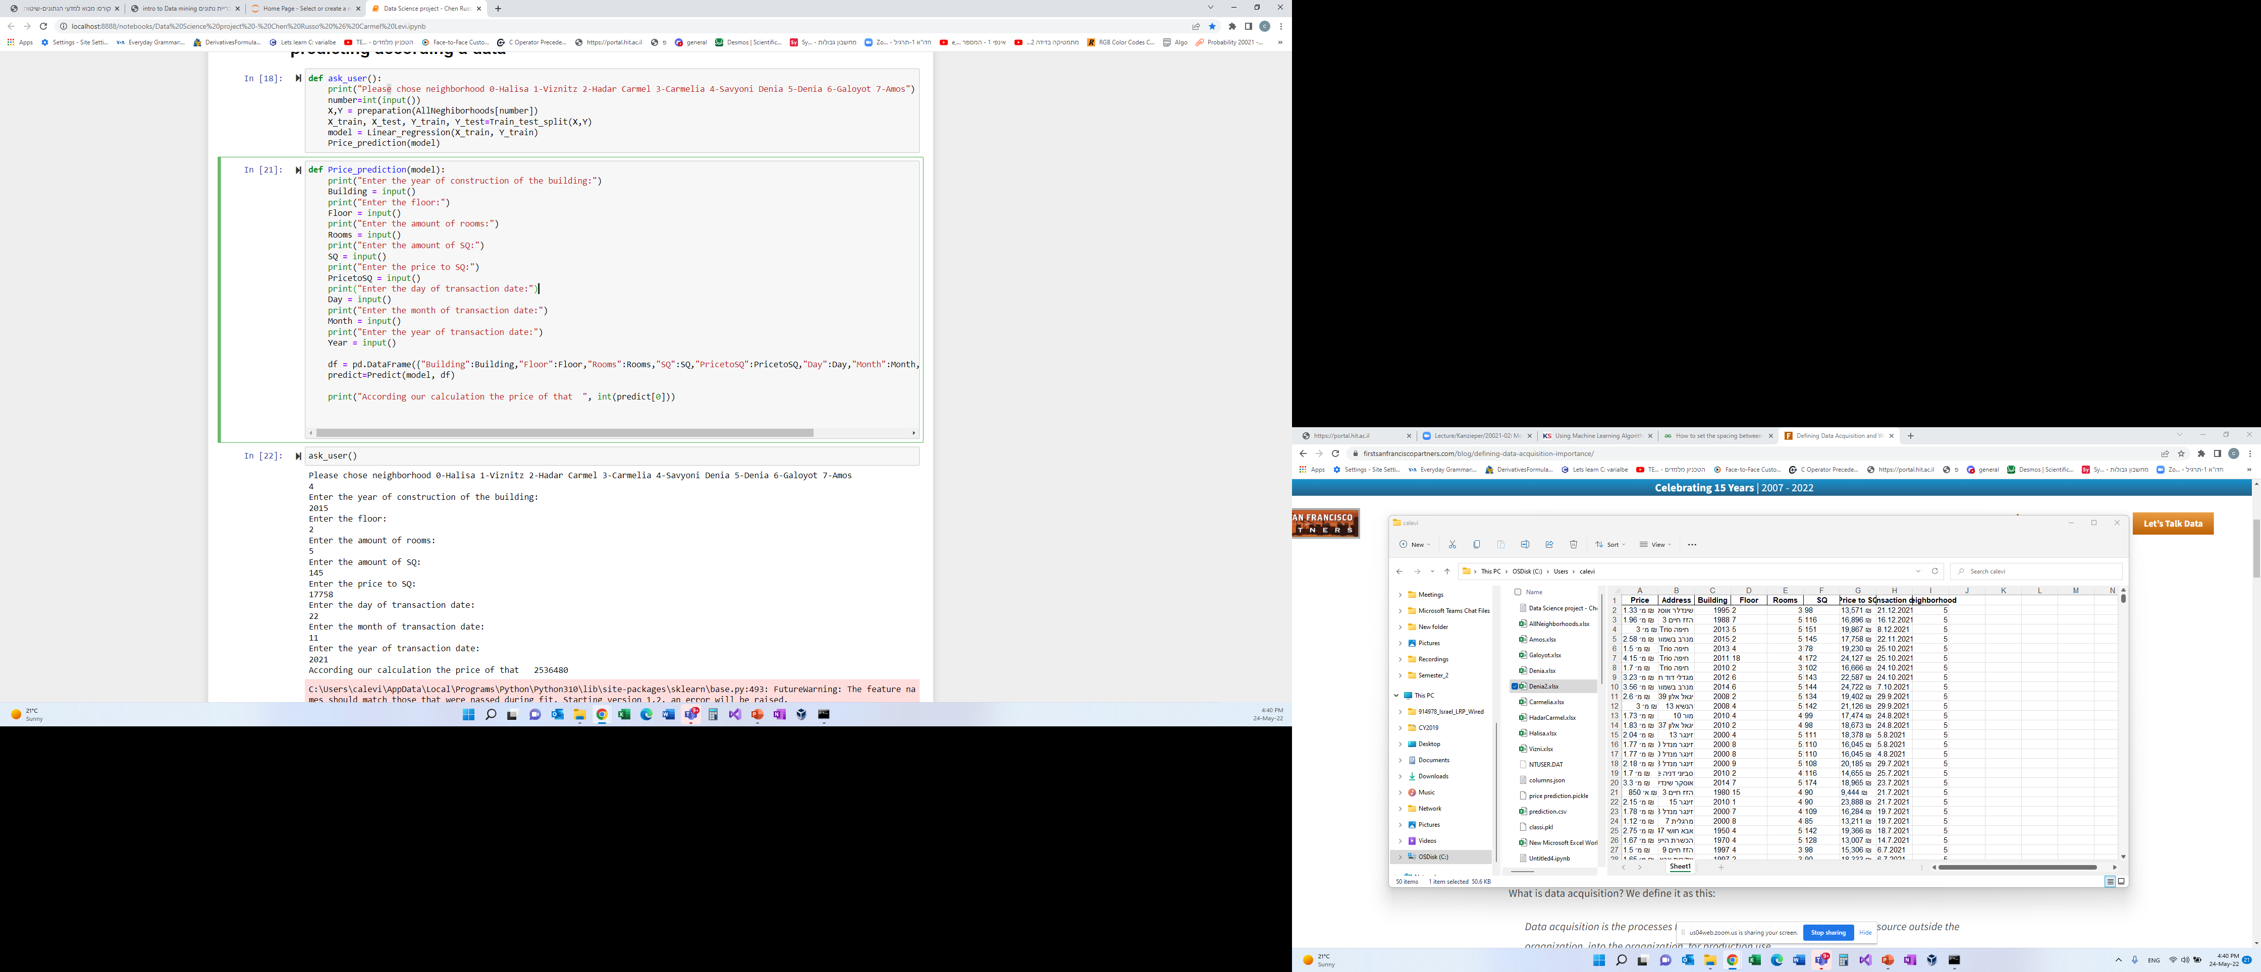



Conclusion& Answer
We can see that by using linear regression we were able to predict a house price based on chosen characteristics.
Example of successful house price prediction –

